Slide 1
Review the Neurocrine H1 Design Pilot Project
Kevin McLoughlin & Jim Brase

Slide 2
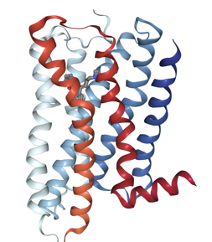
Background
Objective: Demonstrate the value of the ATOM generative molecular design (GMD) process with a realistic lead optimization problem.
First generation H1-antihistamines have undesirable side effects mainly due to off-target activities against muscarinic receptors.
Some of the second generation H1 inhibitors had to be taken off the market because of interference with the hERG channel, leading to cardiac side effects.
For this case study, we are using the GMD active learning framework to generate and evaluate selective H1 antagonists, alternating computational design with experimental testing and model retraining.
PDB ID: 3RZE

Slide 3
Initial model training for H1 and M2
Neurocrine provided single concentration (10 uM) percent binding data for H1, M1-M5 and hERG for about 1900 compounds
Not enough to train regression models because most compounds bound > 90% of receptors
Lots of public IC₅₀ and K_{i} data available, not specialized for Neurocrine chemical space
We developed a hybrid modeling approach combining public K_{i} data with Neurocrine single-concentration data

Slide 4
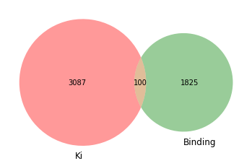
Data for training H1 predictive models
From ChEMBL + GoStar:
1204 uncensored K_{i} values
1883 censored K_{i} values
Convert censored values into binding values by
< → 1% binding at reported K_{i} concentration
> → 99% binding at K_{i} concentration
From Neurocrine:
1925 % binding values
at 10 uM
H1

Slide 5
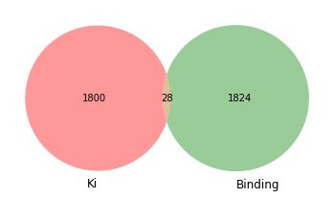
Data for training M2 predictive models
From ChEMBL + GoStar:
1547 uncensored K_{i} values
253 censored K_{i} values
Convert censored values into binding values as for H1
Result is a table of activity values (pKi or % binding) and concentrations for each compound.
From Neurocrine:
1852 % binding values
at 10 uM
M2

Slide 6
Hybrid modeling approach
Novel method to boost pK_{i} or pIC₅₀ model performance using single-concentration data
Neurocrine data are measurements at 10 𝜇M or 10 nM from competitive binding experiments.
Hybrid model is trained to predict pK_{i} first, then infer % binding given pK_{i}, concentrations of drug and radioligand, and K_{d} of radioligand.
Training aims to minimize loss function: sum of 2 kinds of terms depending on type of activity data:
pKi data: (pred_pK_{i} - real_pK_{i})² = normal L2 loss
% binding data: (1 - F_{pred}) - (1 - F_{real}) log(1-F_{pred}) = Poisson loss
where F_{pred} and F_{real} are the predicted and measured fraction of receptors bound to drug
The complicated loss term appears because the noise in radioligand assays is not independent of the measured value - it’s bigger when less drug (and more radioligand) is bound. It works well to model the noise using a Poisson distribution.
The hybrid model is implemented using PyTorch.

Slide 7
Selecting 2nd batch of compounds to test at 10 nM
Neurocrine agreed to run binding assays on 160 compounds at a lower concentration (10 nM), so we could improve our models.
We ran simulations to evaluate 7 different selection schemes, to see which would yield the greatest model improvement.
The best strategy was to emphasize diversity and H1 potency: Cluster the compounds by scaffold and choose the “best” (highest predicted H1 pKi) representative from each cluster.
Selection scheme | Explanation
Original | The original dataset, ChEMBL + GoStar + Neurocrine
H1pKi_ids | Choose 160 compounds with top H1 pKi predictions + H1 % binding > 90
cluster_diff_ids | Cluster the compounds based on scaffold and choose 160 compounds with the largest H1-M2 pKi differences from all clusters
cluster_ids | Cluster the compounds based on scaffold and choose 160 compounds with the highest H1 pKi values from all clusters
diff_ids | Choose 160 compounds with the largest H1 M2 pKi prediction differences
evenly_ids | Evenly choose 160 compounds across the distribution of H1 pKi prediction
hm80_80_ids | Choose 80 compounds with top H1 pKi predictions and 80 compounds with top M2 pKi predictions
random_ids | Randomly choose 160 compounds

Slide 8
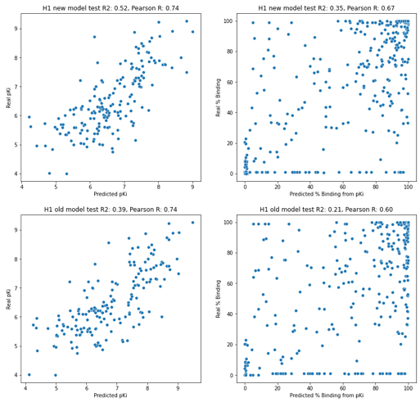
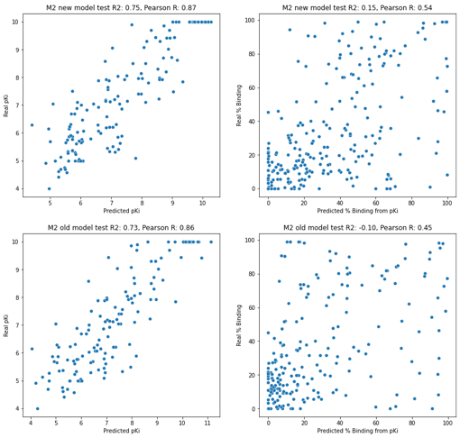
Improved model performance with 10 nM data added to training set
H1
M2
retrained models
original models
pKi data
% binding data
pKi data
% binding data

Slide 9
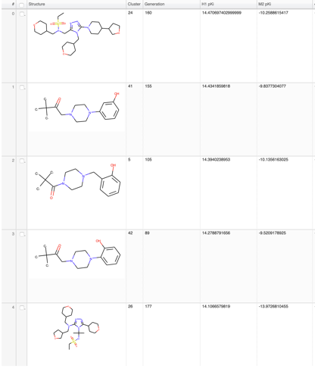
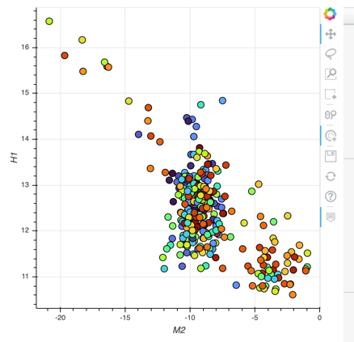
Applicability domain issues for predictive models
Compounds produced by first GMD runs had implausible structures and impossible predicted pKi’s for H1 and M2.
Optimizing for H1 selectivity led to compounds far outside the applicability domain of the models. We needed to add some AD constraints to the GMD optimization.

Slide 10
Z-score based applicability domain index
Use Euclidean distances between feature vectors of compounds.
For each point in the training set, calculate the mean distance of the point to its K nearest neighbors in the training set.
Fit a normal distribution on the mean distances of all training set points.
For each point in the prediction set, calculate the mean distance of the point to its K nearest neighbors in the training set.
Calculate the Z-score of the mean distance of the predicted point based on the distribution of the training set points, rectify the negative Z-scores.
Mathea, M., Klingspohn, W., & Baumann, K. (2016). Chemoinformatic classification methods and their applicability domain. Molecular Informatics, 35(5), 160-180.

Slide 11
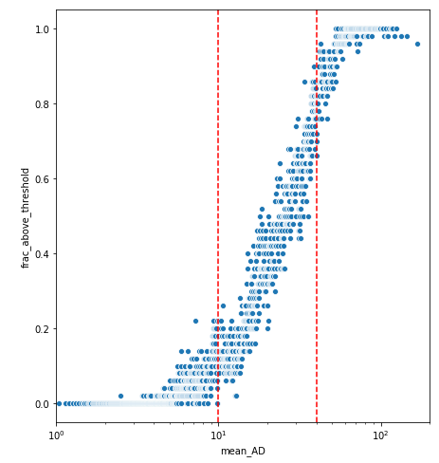
Converting AD indices to probabilities
Fraction of compounds with predicted pKi > max pKi in training set follows a logistic curve.
Fit logistic regression model to predict fraction of values outside training set range.
Add penalty in GMD cost function if probability > ½.
10
40
H1

Slide 12
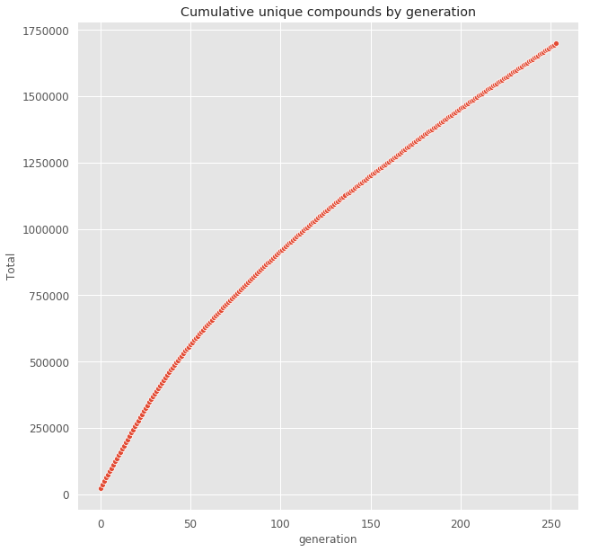
GMD loop - novel compounds by generation
Initial molecule set ~ 25K compounds
GMD loop with AD index constraints ran for 250 generations on initial 25K compound set
Produced and evaluated ~1.75M compounds over about 60 hours of elapsed time.
Toward end of run, ~ 7K/25K compounds evaluated each generation were novel.
Thus, GMD loop continues to explore new parts of chemical space even after many generations.

Slide 13
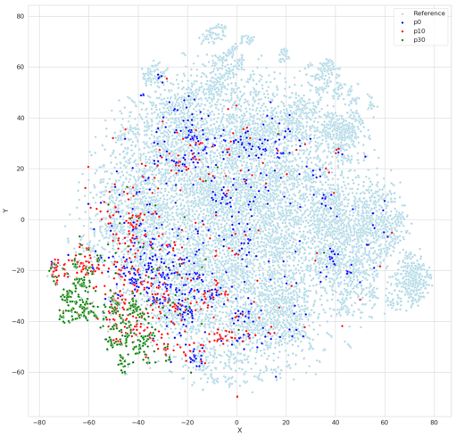
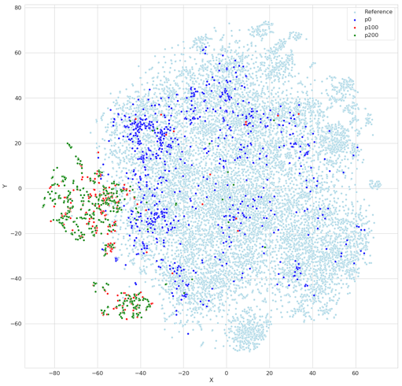
Chemical space visualization

Slide 14
Optimization targets
Pilot Candidate Quality Panel
Efficacy
H1 histamine receptor pKi > 9
M2 muscarinic receptor pKi < 6
Safety
hERG (pIC₅₀ < 5) 10 mmolr = 5 (which is good)
PK
logP (-0.4 - 5.6) Within the range = good
Developability
SAS: Synthetic Accessibility Score < 3
Molecular features: # RotBond < 10, # HBondDonor < 5, # HBondAcceptor < 10, MW (180 ~ 500), TPSA < 140.

Slide 15
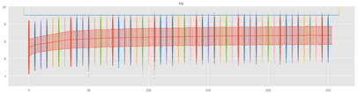
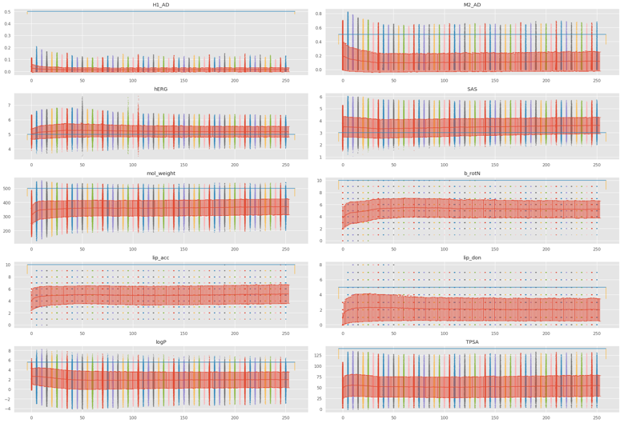
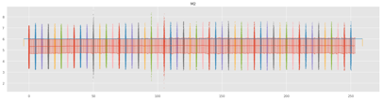
Optimization progress against design targets

Slide 16
GMD Loop: Generated Structures

Slide 17
Experimental Validation
We selected the 2000 top scoring compounds, clustered them by structure and sent the best representative from each cluster to Neurocrine for evaluation.
Also found 95 close matches in Enamine REAL catalog that scored well.
Neurocrine chose 55 for synthesis and is testing them along with the Enamine compounds; expecting results soon.
We’ll use experimental results to retune models and do at least one more GMD round.

Slide 18
Acknowledgements
ATOM Tech Team
Jonathan Allen
Jeff Mast
Da Shi
Sam Ade Jacobs
Brian Van Essen
Amanda Paulson
Stewart He
Sarangan Ravichandran
Hiran Ranganathan
Ya Ju Fan
Jim Brase
Eric Stahlberg
Neurocrine Team
John Williams
John Bucci
Luke Nam
Heather Osswald
Beth Fleck

Slide 19
Questions to the Advisory Board
The project is primarily intended as an engineering demonstration of the generative molecular design process. Are there specific results and metrics that we should be aiming towards?
One of the project technology goals is to do the first integration of the computational workflow with automated chemistry and assays. Neurocrine’s capabilities in this area are still at an early stage. Are there other partners we should consider working with to broaden the effort?
Do you have suggestions for the next stages of work on the molecular design system?

